Slide 1
IT694- Computer Networks Winter 2025
Instructor: P.S. Kalyan Sasidhar
FB2-2109
kalyan_sasidhar@daiict.ac.in

Slide 2
About Me
Associate Professor
Teaching Computer Networks
2014-2015: MTech (Wireless Networks, Cyber Security) Amrita Univ
2016-2020 : BTech, MSc IT
2022-Present : BTech
DAIICT

Slide 3
Course Logistics
Classroom: CEP 207
Teaching Assistants YET TO BE ANNOUNCED
All slides on PDC folder
Assignments, Materials, lab exercises – Google Classroom

Slide 4
Class and lab ATTENDANCE Policy
Institute wide Attendance policy
> 70%

Slide 5
Reference Books
James F. Kurose and Keith W. Ross. 2012. Computer Networking: A Top-Down Approach (6th ed.). Pearson. (RECOMMENDED)
Douglas E. Comer. 2013. Internetworking with TCP/IP (6th ed.). Addison-Wesley Professional.
Andrew S. Tanenbaum and David J. Wetherall. 2010. Computer Networks (5th ed.). Prentice Hall Press, Upper Saddle River, NJ, USA.
Larry L. Peterson and Bruce S. Davie. 2011. Computer Networks, Fifth Edition: A Systems Approach (5th ed.). Morgan Kaufmann Publishers Inc., San Francisco, CA, USA.

Slide 6
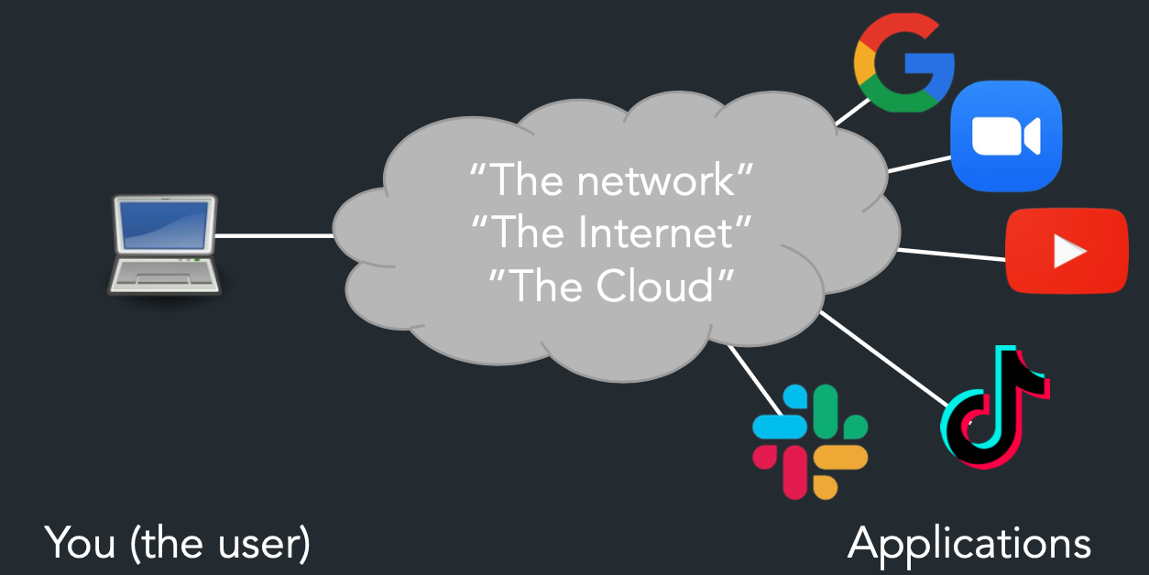
About the Course

Slide 7
What will you learn?
What is a network? What constitutes a network?
What is the Internet? What is WWW?
How invented - the Internet, WWW, Email, etc….?
How do machines connect and send data?
What goes behind the workings of Google, Facebook, Whatsapp, Instagram?
How to find who to talk to
Addresses and names, discovery, routing
Decide how to talk to them
Encodings, Protocols
Make sure communication is correct, only among intended parties, works for all
Mediation, Error correction, encryption, ...

Slide 8
How will you learn?
In-Sem I | 15%
In-Sem II | 15%
End sem | 40%
Labs & Network Programming exercises | 25%
Quizzes | 5%
Lectures – Conceptual understanding
Labs - Practical hands-on
Assignments – Programming
Recall

Slide 9


Slide 10
What’s the Internet: “nuts and bolts” view

Slide 11



















What’s the Internet: “nuts and bolts” view
PC
millions of connected computing devices:
hosts = end systems
running network apps
mobile network
server
wireless
laptop
global ISP
smartphone
home
network
communication links
fiber, copper, radio, satellite
transmission rate: bandwidth
regional ISP
wireless
links
wired
links
Packet switches: forward packets (chunks of data)
routers and switches
router
institutional
network
Notes:
11

Slide 12
What’s the Internet: “nuts and bolts” view
Internet: “network of networks”
Interconnected ISPs
protocols control sending, receiving of msgs
e.g., TCP, IP, HTTP, Skype, 802.11
Internet standards
RFC: Request for comments
IETF: Internet Engineering Task Force
mobile network
global ISP
home
network
regional ISP
institutional
network

Slide 13
What’s the Internet: a service view
mobile network
Infrastructure that provides services to applications:
Web, VoIP, email, games, e-commerce, social nets, …
provides programming interface to apps
hooks that allow sending and receiving app programs to “connect” to Internet
provides service options, analogous to postal service
global ISP
home
network
regional ISP
institutional
network

Slide 14
What is a service that provides an internet data signal on the same network that delivers broadcast television and phone service?
Cable internet
Cellular data plan
Digital Subscriber Line (DSL)
Cable Internet
What is a service that provides high bandwidth, always on, connection using existing land-line telephone wires?
Cellular data plan
Cable internet
Guest access
Digital Subscriber Line (DSL)
Digital Subscriber Line (DSL) connection is a service that provides high bandwidth, always on, connection using existing land-line telephone wires.

Slide 15
A person X recently got a job with a computer support services company in his hometown Gandhinagar. A customer has asked for someone to come connect their home network to the Internet. They only have a cable modem. Which of the following devices would X most likely take with him to complete the task?
wireless router
LAN switch
desktop computer
firewall appliance
wireless router

